Slide 1
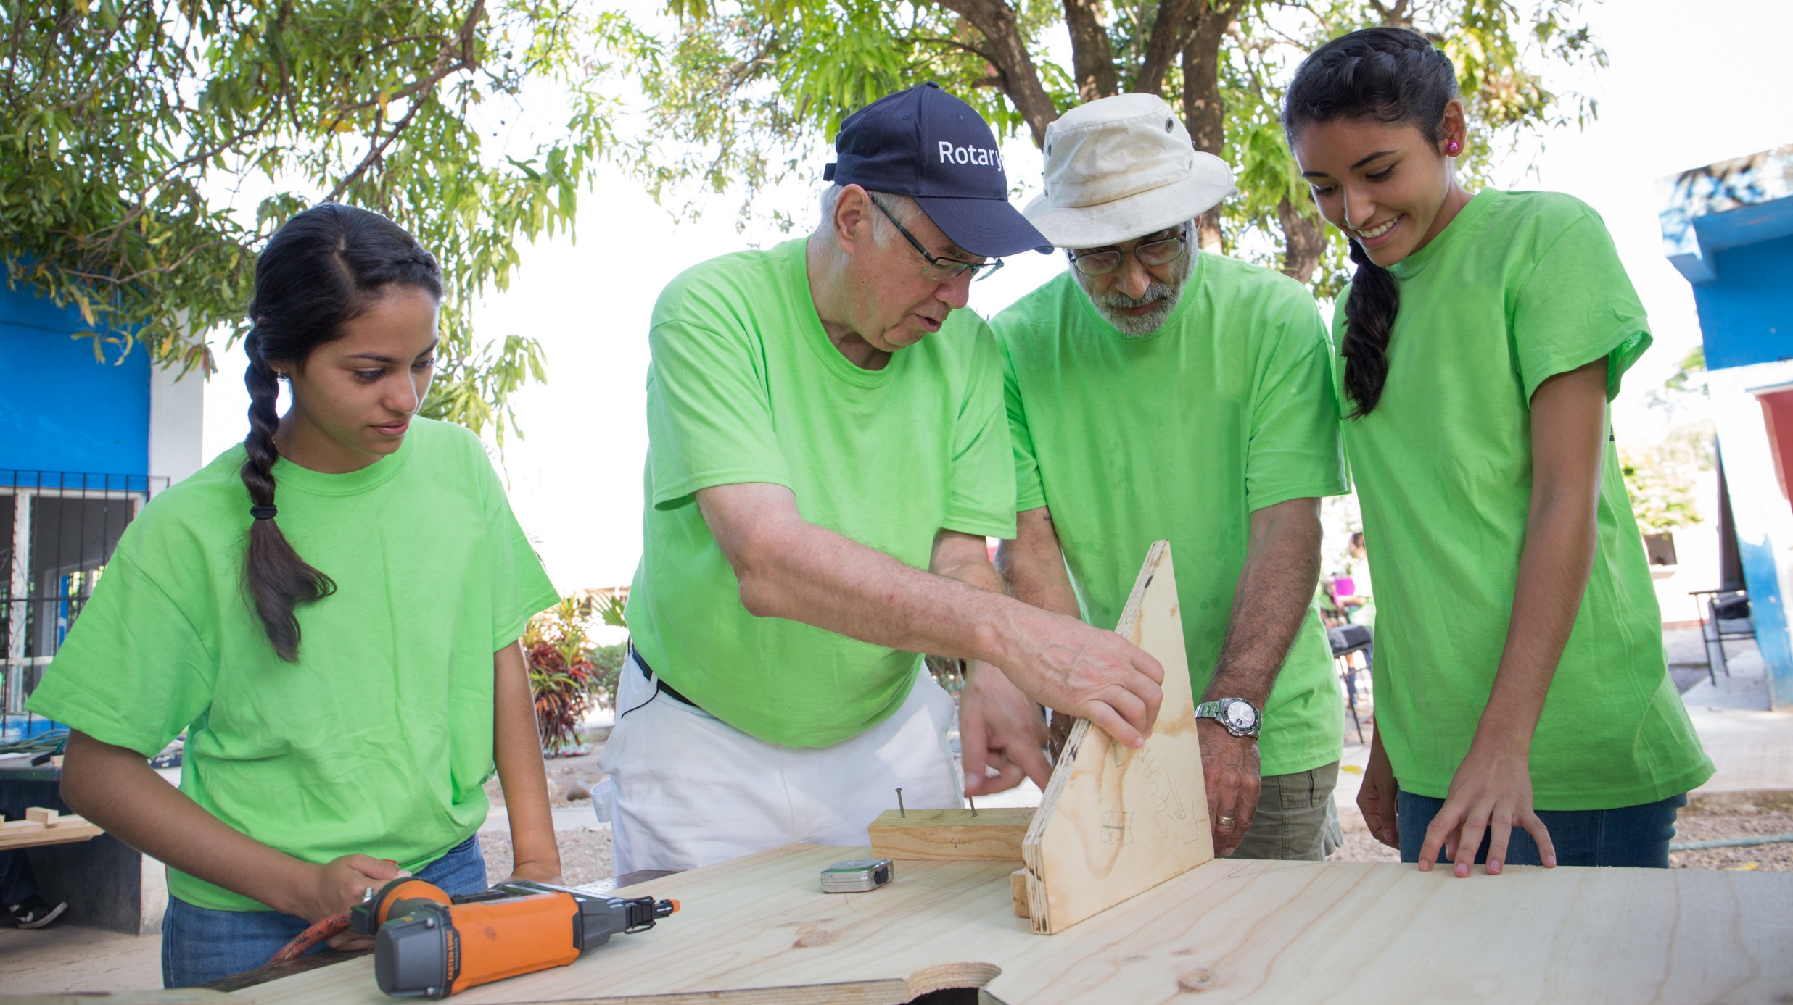
DANUBE ALLIANCE
Engagement through
international service
16.02.2023

Slide 2
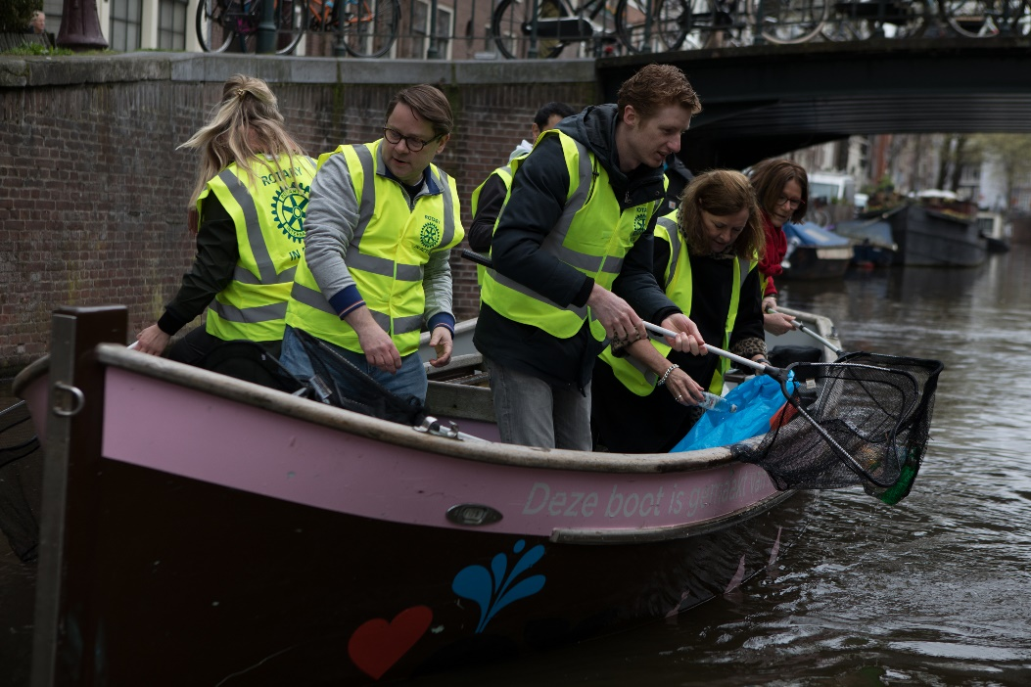

The Idea
Rotarian Danube Alliance for the Rotary Clubs, located on the Danube River coast
To promote teamwork and build long-lasting friendships through the realization of projects with humanitarian and charitable causes in correspondence with the seven areas of focus of Rotary International.

Slide 3
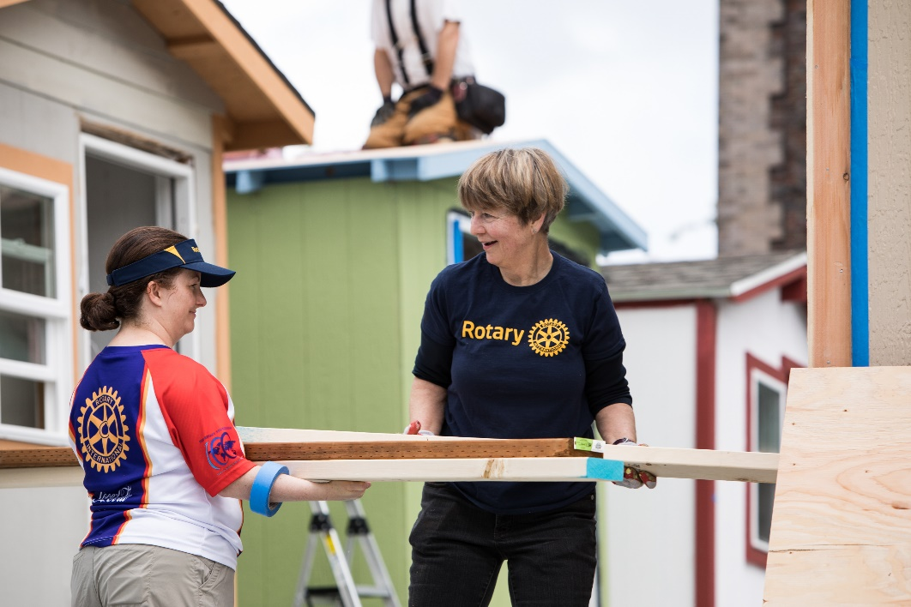
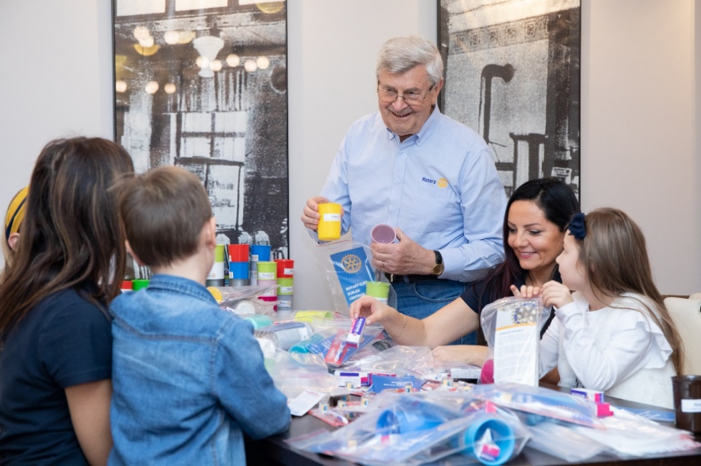
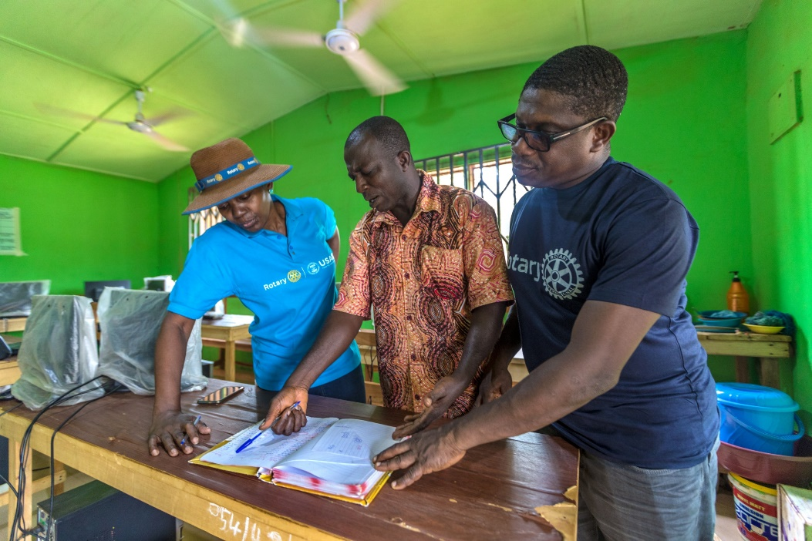
Aims of the Danube Alliance
PROMOTE
LONG LASTING FRIENDSHIPS
SHARE
BEST PRACTICES
COLLABORATE WITH REGIONAL DISRICT & CLUB LEADERS
IDENTIFY AND SUPPORT REGIONAL PROJECTS

Slide 4
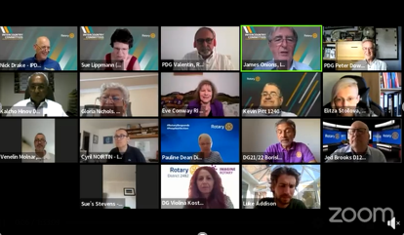
Initial online meeting for the Danube Alliance 18 Nov 2022
Violina Kostova, DG of District 2482-Bulgaria
Hristina Malchevska, International Service Committee Chair District 2482
Veronika Botsova, Vice President Rotaract Europe
Cristian NICULAE, RC Braila, D2241-Romania
Vladimir Nikic, RC Novi Sad – Neoplanta, D2483-Serbia
Vladimir Matic, PDG, RC Beograd Cukarica, D2483-Serbia
Patrik Üveges, RC Budapest Metropolitan, D1911-Hungary
Peter Adler, PDG, President, RC Wien-Grinzing, D1910-Austria
Srđan Urisk, RC Vukovar 1932, District 1913-Croatia
Brigitte Öppinger-Walchshofer, DISC, D1910-Austria
Andrey Dimitrov, President, RC Ruse Danube, D2482-Bulgaria
Annamaria Tari, RC Budapest-Sasad, D1911-Hungary
Walter Ebner, ARC Reg.24, ICC National Coordinator, RC Gmunden, D1920-Austria
Erzsébet Kovácsné Gila, DGE, RC Szentes-Csongrad
Plamen Petrov, President, RC Svishtov, D2482-Bulgaria
Margarita Bogdanova, DGN, RC Svishtov, D2482-Bulgaria
Nikolay Kostov, President, RC Silistra, D2482-Bulgaria
Hirsto Sirashki, RC Svishtov, D2482-Bulgaria
György Thaler, RC Budapest-Sasad, D1911-Hungary
Erzsébet Kovácsné Gila, DGE, RC Szentes-Csongrad, D1911-Hungary
Ani Hristova, Member of International Service Committee, D2482-Bulgaria
Annamaria Tari, DGN, D1911-Hungary
Henning, RC Budapest-City, D1911-Hungary
Michael J. Sessier, RC Bad Bederkesa, D1850-Germany
Nasko Pekov, President, RC Vidin, D2482-Bulgaria
Zoltan Györök, RC Baja, D1911-Hungary
Radost Petrova, RC Russe, D2482-Bulgaria
27 presidents or representatives of the Rotary clubs, Districts from 7 countries participated.
All embraced the idea and we are happy to proceed.

Slide 5
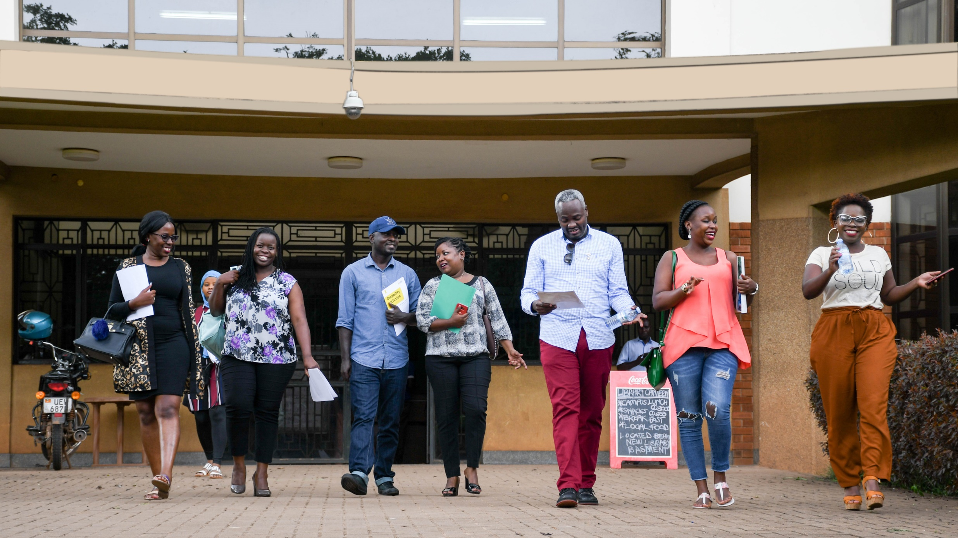
Joint project ideas

Slide 6
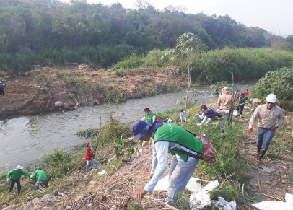
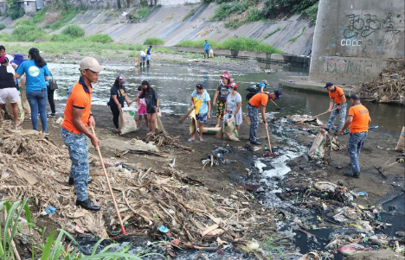
Ideas for joint Danube cause / project
Some of the ideas for a joint project shared at the meeting:
- A project in connection with the Danube river
- In the areas of Ecology / Environment – traffic wise, clean water, shipping road
- Tourism project

Slide 7
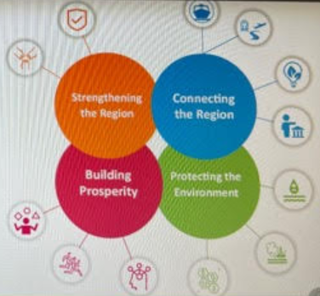
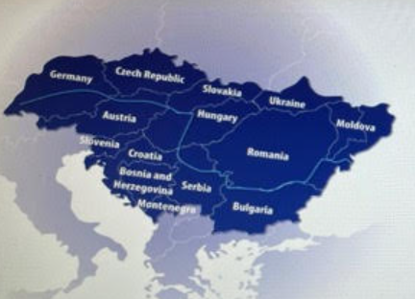
Proposal for joint Danube project – Austria, District 1910
Mag. Brigitte Öppinger-Walchshofer,
President RCVI
Chapter Chair ICC with Spain
International Service RCVI 2022/2023
International Service Chair, District 1910, Austria East and Bosnia and Hercegovina
shared European Danube River Strategy and proposed to be inline with it for the priority 10 which deal with institutional capacity and cooperation and gives room for Civil Society and the youth.
Goals of EUDS
Countries connected to the river

Slide 8
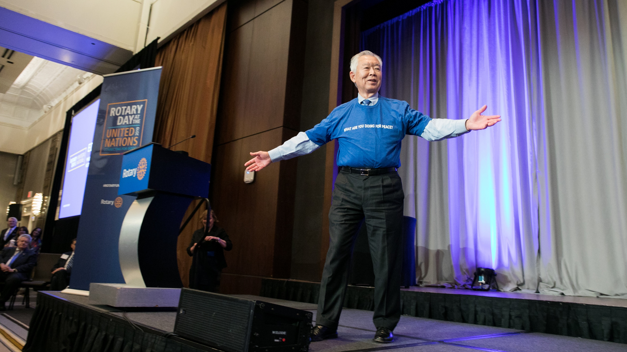

Let’s meet in person
Proposal for a joint meeting in person

Slide 9


Short Draft program proposal Danube Alliance meeting Spring 2023 - Arrivals
Where:
Vidin in Bulgaria
Transportation to Vidin, Bulgaria?

Slide 10
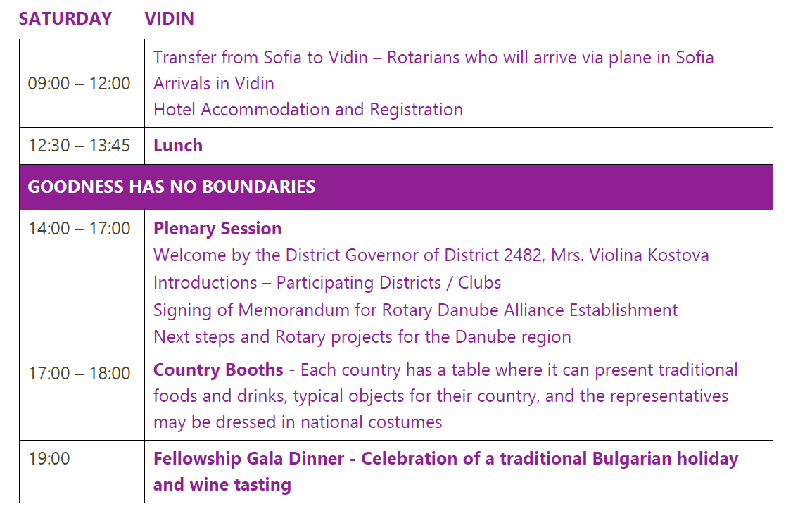
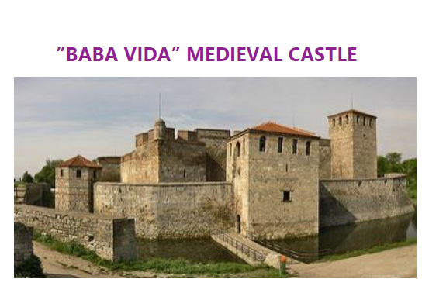
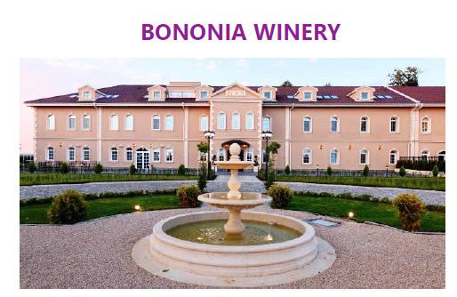
Short Draft program proposal Danube Alliance meeting Spring 2023 – Day 2

Slide 11
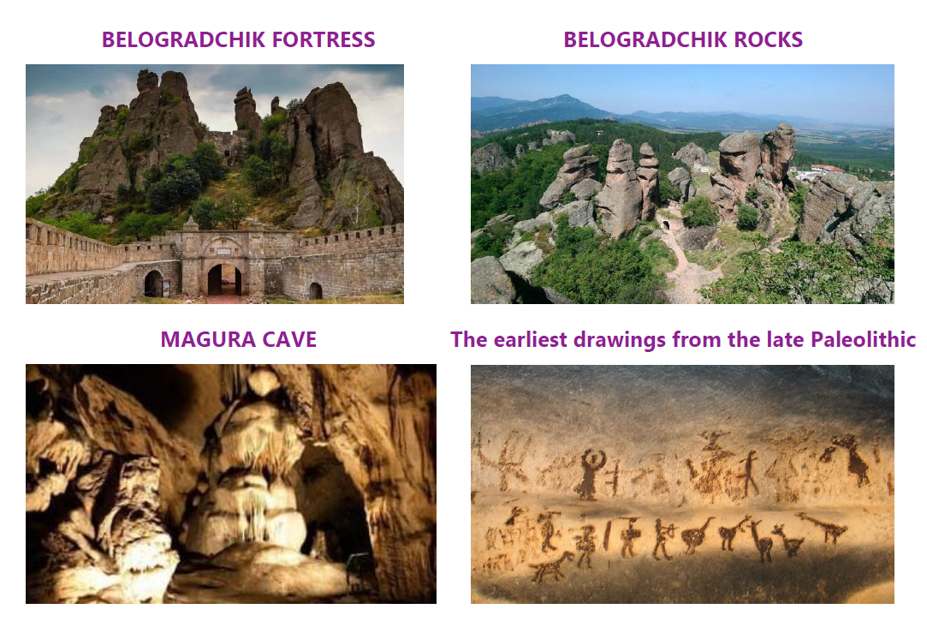

Short Draft program proposal Danube Alliance meeting Spring 2023 – Day 3

Slide 12

DISSCUSION AND NEXT STEPS

Slide 13

Thank you☺

